Slide 1


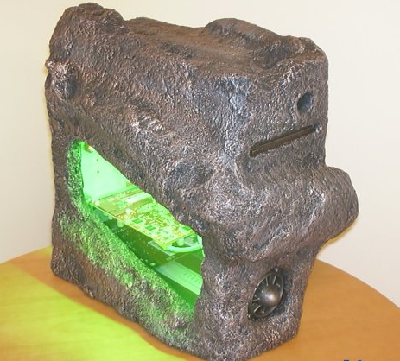
Computer Networks Performance Evaluation

Slide 2
Chapter 4
Performance Engineering Methodology
Performance by Design:
Computer Capacity Planning by Example
Daniel A. Menascé, Virgilio A.F. Almeida, Lawrence W. Dowdy
Prentice Hall, 2004

Slide 3

Outline
4.1 Introduction
4.2 Performance Engineering
4.3 Motivating Example
4.4 A Model-based Methodology
4.5 Workload Model
    4.5.1 Types of Workload Models
    4.5.2 Clustering Analysis
4.6 Performance Models
4.7 Specifying Performance Objectives
    4.7.1 Specifying a Service Level Agreement
    4.7.2 Specifying Response Time
    4.7.3 Specifying Cost
4.8 Concluding Remarks
4.9 Exercises
Bibliography

Slide 4
Central Question
Here is a central question:
  how can one plan,
  design,
  develop,
  deploy and
  operate IT services that
meet the ever increasing demands for
  performance,
  availability,
  reliability,
  security, and
  cost?

Slide 5
Specific Questions
Specific Questions:
Is a given IT system properly designed and sized for a given load condition?
Can the insurance claims management system meet the performance requirement of sub-second response time?
Is the infrastructure of a government agency scalable and can it cope with the new online security policies required for financial transactions?
Can the security mechanisms be implemented without sacrificing user-perceived performance?
Is the reservations system for cruise lines able to respond to the anticipated peak of consumer inquiries that occurs after a TV advertisement campaign?

Slide 6
System Analysis
By breaking down the complexity of an IT system, one can analyze
  the functionality of each component,
  evaluate service requirements, and design and
  operate systems that will meet user's expectations.
Answer to the questions requires a deep understanding of the system architecture and its infrastructure.
This chapter presents the basic steps of a methodology for performance engineering that are needed to fulfil the major performance needs of IT services.

Slide 7
Outline
4.1 Introduction
4.2 Performance Engineering
4.3 Motivating Example
4.4 A Model-based Methodology
4.5 Workload Model
    4.5.1 Types of Workload Models
    4.5.2 Clustering Analysis
4.6 Performance Models
4.7 Specifying Performance Objectives
    4.7.1 Specifying a Service Level Agreement
    4.7.2 Specifying Response Time
    4.7.3 Specifying Cost
4.8 Concluding Remarks
4.9 Exercises
Bibliography

Slide 8
Performance Engineering
It has been a common practice in many systems projects to consider performance requirements only at the final stages of the software development process.
As a consequence, many systems exhibit performance failures that lead to delays and financial losses to companies and users [25].
Performance engineering analyzes the expected performance characteristics of a system during the different phases of its lifecycle.

Slide 9
Performance Engineering Task
Performance engineering Tasks:
1) Develops practical strategies that help predict the level of performance a system can achieve.
2) Provides recommendations to realize the optimal performance level.

Slide 10
Activities
Both tasks rely on the following activities that form the basis of a methodology.
  Understand the key factors that affect a system's performance.
  Measure the system and understand its workload.
  Develop and validate a workload model that captures the key characteristics of the actual workload.
  Develop and validate an analytical model that accurately predicts the performance of the system.
  Use the models to predict and optimize the performance of the system.

Slide 11
Collection of Methods
Performance engineering can be viewed as a collection of methods for the support of the development of performance-oriented systems throughout the entire lifecycle [7].
The phases of the system lifecycle define
  the workflow,
  procedures,
  actions, and
  techniques
that are used by analysts to produce and maintain IT systems.
This methodology is based on models that are used to provide QoS assurances to IT systems.

Slide 12
Performance Engineering Models
These models are:
  workload model,
  performance model,
  availability model,
  reliability model, and
  cost model.
  At the early stages of a project, the information and data available to develop the models are approximate at best.

Slide 13
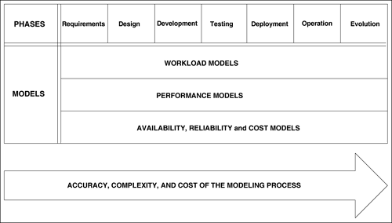
Figure 4.1. Modelling process. spectrum of the models for the different phases, ranked from least to most complex and costly.
as complexity and cost increase, the refined models becomes more accurate

Slide 14
Models Evolve
In the requirement analysis stage, it is difficult to construct a detailed workload model, specifying the demands placed by transactions on the system's resources.
As the project evolves, more system information becomes available, reducing the error margin of the model's assumptions and increasing confidence in the estimated predictions of the future system's performance [23].
The workload and performance models evolve side by side with the system project throughout the stages of its lifecycle.
Various types of workload and performance models can be used during the system lifecycle.

Slide 15
Outline
4.1 Introduction
4.2 Performance Engineering
4.3 Motivating Example
4.4 A Model-based Methodology
4.5 Workload Model
    4.5.1 Types of Workload Models
    4.5.2 Clustering Analysis
4.6 Performance Models
4.7 Specifying Performance Objectives
    4.7.1 Specifying a Service Level Agreement
    4.7.2 Specifying Response Time
    4.7.3 Specifying Cost
4.8 Concluding Remarks
4.9 Exercises
Bibliography

Slide 16
Motivating Example
Facing sharp competition, consider an automotive parts distribution company that has decided to develop and implement a new call centre.
The goals of the new call centre system are to:
  1) foster better relationships with customers, creating customer loyalty and ensuring quality service,
  2) improve efficiency and service performance, and
  3) identify and explore new sales opportunities.

Slide 17
Integrated Customer
The information technology team has decided to create an integrated customer relationship management system.
The proposed new architecture consists of computer telephony integration software that controls inbound calls and routes these calls to service representatives integrated with the application software.
Figure 4.2 depicts an overview of the call centre architecture.

Slide 18
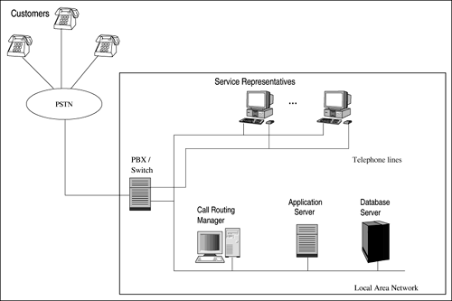
Figure 4.2. Architecture of the call centre.

Slide 19
What is a call Center
A call centre (UK) or call center (US) is a centralized office of a company that answers incoming telephone calls from customers.
A call center may be an office that makes outgoing telephone calls to customers (telemarketing).
Such an office may also responds to letters, faxes, e-mails and similar written correspondence.
  However the term contact centre (UK) or contact center (US) is often applied when such multiple functions are blended in one office.

Slide 20
Call Center
The call centre will be staffed by service representatives who handle customer orders,
  returns,
  queries by phone,
  fax, and
  e-mail.
Basically, customers inquire about:
  1) the status of an order,
  2) the location of a shipment, and
  3) problem resolution status.

Slide 21
Basic Function
Each customer service representative will have immediate access to the following basic functions:
  1) historical tracking of all customer contacts,
  2) a single view of customer information,
  3) records of resolution of past problems, and
  4) help functions.
Management realizes that customers are less tolerant of long calls.
Thus, the system should meet sub-second response times on all functions and be operational 24 hours a day, 7 days a week.

Slide 22
Scenarios
Various scenarios when designing its call centre.
The IT team is planning to
  design,
  build,
  test, and
  deploy the new call centre applications in 12 months.

Slide 23
Questions-1
Before rollout, management wants assurances that the performance requirements are satisfied.
Questions that project management asks include:
  Is the system design able to meet the sub-second response time for all functions?
  What will be the impact of doubling the number of system representatives in the next year?

Slide 24
Questions-2
Can acceptable performance levels be maintained after integrating the system with the mainframe-based inventory application?
Is the system capacity adequate to handle up to 1,000 calls in the busiest hour and yet preserve the sub-second response time goal?
How do failures in the database server affect the 24x7 availability goal?
What is the impact of starting to offer Web-based self-service to customers?

Slide 25
Initial Idea
During the requirement analysis stage, the analysts specify the type of system architecture and the resources that will support the QoS goals for the system.
The analysts want an initial idea about the models that will be used in the performance engineering analysis phase.

Slide 26
Workload Model-1
Consider a first attempt for a workload model.
Initially, one needs to define the workload to be characterized.
There are multiple and different workloads in a system depending on the point of view from which one looks at the workload.
The workload presented to the call centre system consists of the rate of telephone calls into the call centre.

Slide 27
Workload Model-2
From the IT application standpoint, the workload consists of all functions it receives from the representatives during an observation period.
A database server may receive queries from the application server, which in turn receives function execution requests from the representatives.
The load of the local network is usually described in terms of its traffic characteristics, including the
  packet size distribution and
  the inter-packet arrival time.

Slide 28
Workload Model-3
A second issue that must be about the workload model is the level of detail its description.
A high-level description specifies the workload from the user's point of view.
For instance, one could specify the load in terms of functions submitted by the users.
On the other hand, a low-level characterization describing the user's requests in resource-oriented terms

Slide 29
Performance Model
Initially, the performance model is a simple black box.
The desired output of the model includes
  throughput,
  response time, and
  availability.

Slide 30
Performance Model-2
Consider the call center system described in the motivating example.
During the system design stage, the analyst needs to answer the following question:
  what should be the system throughput to meet the sub-second response time requirement?
At this stage, the analyst makes assumptions such as:
  1) the number of service representatives will be 200, and
  2) during the busiest hour, 80% of the representatives are working simultaneously answering calls.

Slide 31
Interaction Model
The conversation of a representative with a customer can be represented by a simple interaction model.
The representative
  listens to the customer,
  selects a function,
  submits it to the system,
  waits for the system to respond,
  watches while the results appear,
  talks to the customer,
  terminates the call, and
  waits for another customer call.
The think time corresponds to the period of time between a reply to a function execution request and the following submission.

Slide 32

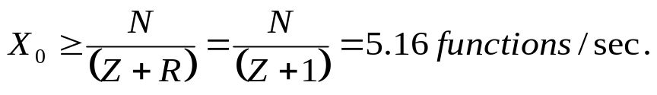
Example 4.2
At this stage of the project, the analyst's view of the call centre application is a black box, modelled by Fig. 4.3
The analyst estimates an average think time of 30 sec, denoted by Z.
The number of active representatives in the system, denoted by N, is equal to 200 x 0.8.
The system throughput is denoted by X₀.
If the response time, R, is not to exceed 1 second, it follows from the Interactive Response Time Law (see Chapter 3) that
Then,

Slide 33
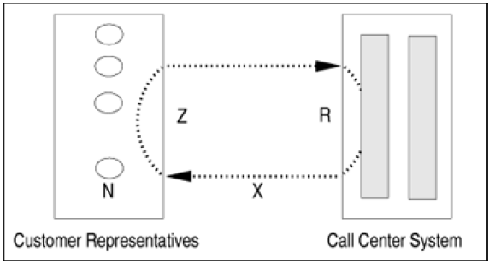
Figure 4.3. Model of the call center system.

Slide 34
Database Throughput-1
During the system development phase, the various components of the system are implemented.
Suppose that during this phase, the analysts determine that each function submitted by a representative demands 2.2 queries from the database server.
Before developing the database component of the system, they need to know the required capacity of the database server that is needed to meet the performance objectives.
The Forced Flow Law, discussed in Chapter 3, applied to the database server establishes a relationship between the database server throughput and the system throughput.

Slide 35

Database Throughput-2
(4.3.1)
That is,
where X_{DB} is the database server throughput, X₀ denotes the total system throughput, and V_{DB} is the average number of visits per function to the database server.
The minimum database server throughput, in queries/sec, is obtained in Example 4.2 as X₀ ≥ 5.16 functions/sec.
Considering that the minimum system throughput is 5.16 functions/sec and each function accesses the database server 2.2 times,
the minimum database server throughput, measured in queries per second is

Slide 36
Measurement
Measuring the performance of the call center applications is a key issue in the process of guaranteeing the quality of service objectives.
It is also an essential step for performance engineering, because it collects data for performance analysis and modelling.
These measurement data are used to calculate the model input parameters, which describe
  the system configuration,
  the software environment, and
  the workload of the call center system.

Slide 37


Time Decomposition
Let the average response time be denoted by R_{call}.
The response time can be decomposed into three main components:
where represent the response time at
  the application server,
  the Local Area Network, and
  the database server,
respectively.

Slide 38
Performance Verification
The description of the motivating example provides a performance requirement that R_{call} < 1.
In the operation stage, the system is constantly monitored to verify that performance objectives are being met.
During the peak hour, the system shows signs of saturation, with average response times longer than one second.
Management is considering upgrading the database server and wants to know what component of the server is most responsible for slowing down its response time.

Slide 39
Questions
The relevant questions include:
  What is the average response time per query?
  What is the average throughput of the DB server?
  What are the utilizations of the CPU and disks?
For the sake of simplicity, consider that the database server services only one type of transaction: query.
  The DB server has one CPU and two disks.
During the peak period, the DB server receives requests from the application server at a rate of 57,600 queries per hour.

Slide 40
Parameters
Based on measurements collected during the operation of the call center application, the analyst obtains the following data:
on average, each query needs 50 msec of CPU and performs four I/Os on disk 1 and two I/Os on disk 2.
Each I/O takes an average of 8 msec.
The throughput, X₀, is equal to the average arrival rate λ, given by:
  57,600/3,600 = 16 queries/sec.
The service demand at the CPU, D_{CPU}, is 0.050 sec.

Slide 41
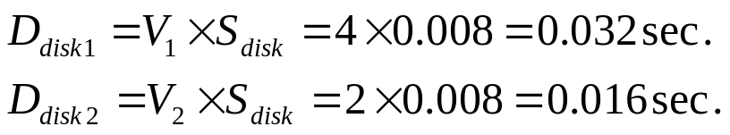


Service Demands
The service demand at the CPU, D_{CPU}, is 0.050 sec.
The service demands at disks 1 and 2 are: From the Service Demand Law (see Chapter 3),
Therefore, the utilization of the CPU and the disks are given by:
respectively.

Slide 42
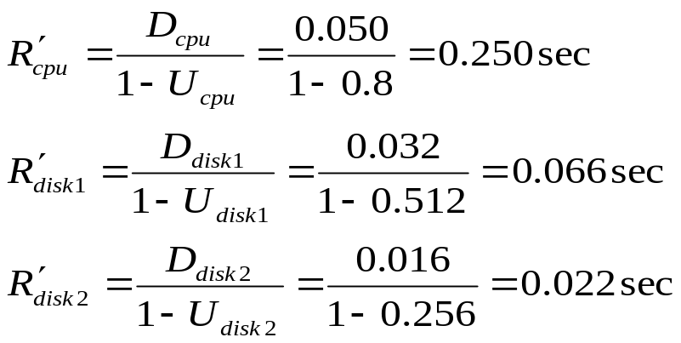
Residence Time
Using the residence time equation for open queuing networks of Chapter 13, the residence times at the CPU and disks are:
The total response time is the sum of all residence times.

Slide 43
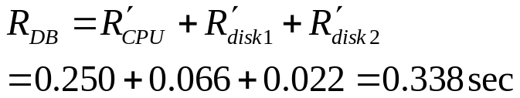
Result
Thus, The CPU is the bottleneck since it has the largest service demand.
As the load increases, the CPU utilization will reach 100% before any other device and will limit the throughput of the database server.

Slide 44
Call Center Evolution
Now consider the evolution stage of the call center system.
The company is considering to develop Web applications to allow customers access to the information they need without assistance from a customer representative.
Web self-services reduce transaction costs and enhance the customer experience.
To let users directly access the call center database, management wants to make sure that security requirements will be met.
Security depends on the context in which security issues are raised [4].

Slide 45
New Requirement
In the business context, the security emphasis is on the protection of assets.
Management wants to minimize the risk of unauthorized modification of the information in the call center database.
Thus, software engineers involved need to design a new type of transaction that satisfies the security requirements.
The security requirement has implications on two areas of the system [4]:
  interface and
  internal architecture.

Slide 46
New Interface, Audit
The new interface should include authentication services that perform the mapping between the user's identity and the person using the system.
New auditing features should be included to aid administrators discover the history of unauthorized access in the event of a security breach.
In terms of the internal architecture, the designers plan to modify the access control mechanisms to the database information.
Before embarking on the developing and implementation of the Web application, management wants to assess the likely impact of the new application on the call center service.

Slide 47
Parameters
From the software model [25], the analyst is able to estimate the service demands for the new class of transactions, submitted via the Web.
A new performance model for the database server is developed.
The database server model is subject to two types of transactions:
  local queries and
  Web queries.
  the arrival rate of local queries transactions is 16 tps and
  the arrival rate of Web queries transactions is 1 tps.
The service demands for the
  CPU,
  disks 1, and
  disk 2, are given in Table 4.1.

Slide 48
Table 4.1. Service Demands and Arrival Rates of Database Transactions for Ex. 4.5
 | Local Queries | Web Queries
Arrival Rate (tps) | 16 | 1
Service Demands (sec)
CPU | 0.050 | 0.150
Disk 1 | 0.032 | 0.200
Disk 2 | 0.016 | 0.100

Slide 49
Open Queuing Network
Using the equations for the multiple-class case of open queuing networks (see Chapter 13) and the OpenQN.XLS MS Excel workbook the model can be solved and the results show management the impact of Web transactions on call center applications.
The response times for local queries and Web queries at the database server are 1.14 sec and 3.85 sec, respectively.
These numbers provide management with a concrete sense of the impact of implementing Web applications on the current infrastructure of the call center system.

Slide 50
Outline
4.1 Introduction
4.2 Performance Engineering
4.3 Motivating Example
4.4 A Model-based Methodology
4.5 Workload Model
    4.5.1 Types of Workload Models
    4.5.2 Clustering Analysis
4.6 Performance Models
4.7 Specifying Performance Objectives
    4.7.1 Specifying a Service Level Agreement
    4.7.2 Specifying Response Time
    4.7.3 Specifying Cost
4.8 Concluding Remarks
4.9 Exercises
Bibliography

Slide 51
A Model-based Methodology
This section describes the basic steps used to design and analyze computer systems with performance in mind.
The methodology builds on workload and performance models and can be used throughout the phases of the system lifecycle.
Performance engineering provides a series of steps to be followed in a systematic way [2].
Figure 4.4 gives an overview of the main steps of the quantitative approach to analyze the performance of a system.

Slide 52
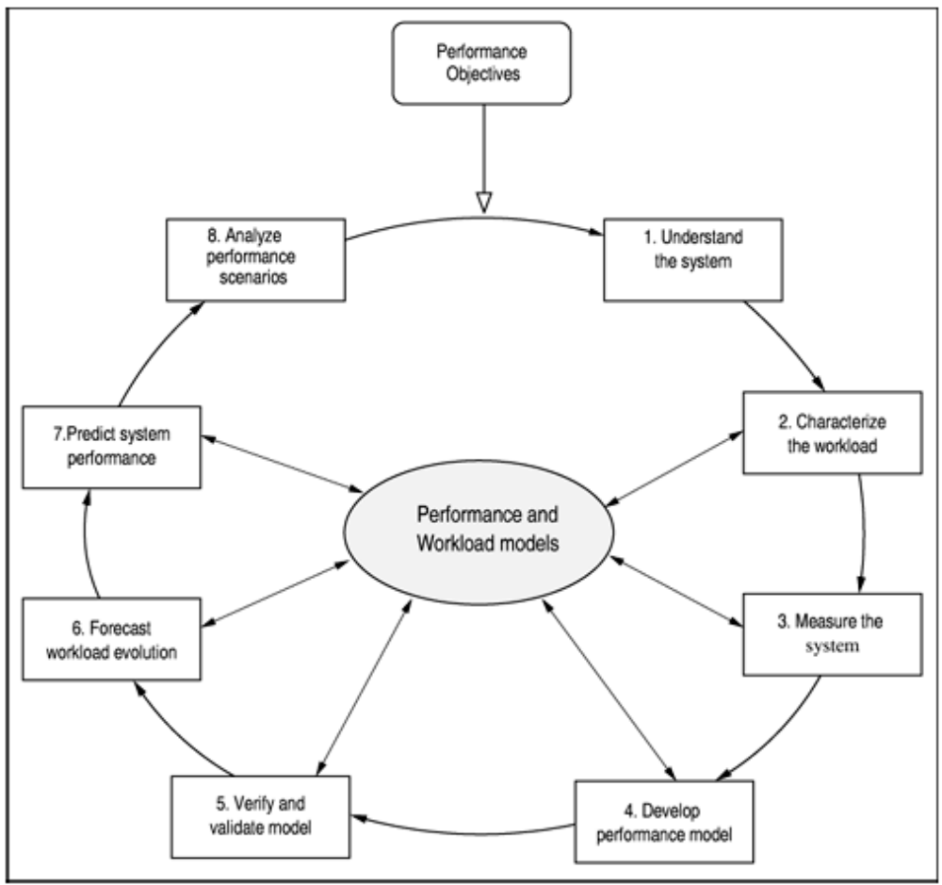
Figure 4.4. A model-based performance engineering methodology.

Slide 53
Performance Objective
The starting point of the methodology is to specify system performance objectives.
These objectives should be quantified as part of the system requirements.
  Performance objectives are used to establish service level goals.
  Service level goals are defined,
  Business metrics are established, and
  Performance goals of the system are documented.
Once the system and its quantitative objectives have been determined, one is able to go through the quantitative analysis cycle.

Slide 54
1-Understand the System,
Understand the system.
  Obtain an in-depth understanding of the system architecture and
  Conduct an architecture-level review with emphasis on performance.
    This means answering questions such as:
      What are the system requirements of the business model?
      What type of software (i.e., operating system, transaction monitor, DBMS, application software) is going to be used in the system?

Slide 55
1-Understand the System.
  This step yields a systematic description of the system architecture, its components, and goals.
  It is an opportunity to review the performance issues of the proposed architecture.

Slide 56
2-Characterized the Workload
Characterize the workload.
  In this step, the basic components that compose the workload are identified.
    The choice of components depends both on the nature of the system and the purpose of the characterization.
  The product of this step is a statement such as "The workload under study consists of e-business transactions, e-mail messages, and data-mining requests."

Slide 57
2-Characterized the Workload
The performance of a system with many clients, servers, and networks depends heavily on the characteristics of its load.
Thus, it is vital in any performance engineering effort to understand clearly and characterize accurately the workload [8, 13].
The workload of a system can be defined as the set of all inputs that the system receives from its environment during any given period of time.
For instance, if the system under study is a database server, then its workload consists of all transactions (e.g., query, update) processed by the server during an observation interval.

Slide 58
3-Measure the System,
Measure the system and obtain workload parameters.
  The third step involves measuring the performance of the system and obtaining values for the parameters of the workload model.
  Measurement is a key step to all tasks in performance engineering.
  It allows one to understand the parameters of the system and to establish a link between a system and its model.
  Performance measurements are collected from different reference points, carefully chosen to observe and monitor the environment under study.

Slide 59
3-Measure the System,
For example, consider that a database server is observed during 10 minutes and 100,000 transactions are completed.
The workload of the database during that 10-minute period is the set of 100,000 transactions.
The workload characteristics are represented by a set of information e.g.,
  arrival and completion time,
  CPU time, and
  number of I/O operations) for each of the 100,000 database transactions.

Slide 60
4-Develp Performance Model
Develop performance models.
  In the fourth step, quantitative techniques and analytical (or simulation or prototype) models are used to develop performance models of systems.
  Performance models are used to understand the behaviour of complex systems.
  Models are used to predict performance when any aspect of the workload or the system architecture is changed.
  Simple models based on operational analysis discussed in Chapter 3 are accessible to software engineering practitioners.
  They offer insight into how software architectural decisions impact performance [11].

Slide 61
5-Verify and Validate,
Verify and validate the models.
  The fifth step aims at verifying the model specifications and validating the model's results.
  This step applies to both, performance and workload models.
  A performance model is said to be validated if the performance metrics (e.g., response time, resource utilizations, throughputs) calculated by the model match the measurements of the actual system within a certain acceptable margin of error.

Slide 62
5-Verify and Validate.
As a rule of thumb, resource
  utilizations within 10%, system
  throughput within 10%, and
  response time within 20% are considered acceptable [16].
A model is said to be verified if its results are an accurate reflection of the system performance [25].
Details of performance model calibration techniques are available [16].
In summary, this step answers questions such as:
  Is the right model for the system being considered?
  Does the model capture the behaviour of the critical components of the system?

Slide 63
6-Forecast Workload Evolution,
Forecast workload evolution.
Most systems suffer modifications and evolutions throughout their lifetime.
As a system's demands change, so do workloads.
  Demands grow or shrink, depending on many factors, such as
    the functionalities offered to users,
    number of users,
    hardware upgrades, or
    changes to software components.

Slide 64
6-Forecast Workload Evolution.
The sixth step forecasts the expected workload for the system.
Techniques and strategies for forecasting [12] workload changes should provide answers to questions such as:
  What will be the average size of e-mails by the end of next year?
  What will be the number of simultaneous users for the online banking system six months from now?

Slide 65
7-Predict System Performance,
Predict system performance.
  Performance guidance is needed at each stage of the system lifecycle, since every architectural decision can potentially create barriers in achieving the system performance goals.
  Thus, performance prediction is key to performance engineering work, because one needs to be able to determine how a system will react when changes in load levels and user behaviour occur or when new software components are integrated into the system.
  This determination requires predictive models.

Slide 66
7-Predict System Performance.
  Experimentation, is not usually viable because fixing performance defects may require structural changes that are expensive.
  In the seventh step, performance models are used to predict the performance of a system under many different scenarios.

Slide 67
8-Analyze Performance Scenarios,
Analyze performance scenarios.
  Validated performance and workload models are used to predict the performance of a system under several different scenarios, such as
  upgraded servers,
  faster networks,
  changes in the system workload,
  changes to the user behaviour, and
  changes to the software system.

Slide 68
8-Analyze Performance Scenarios.
To help find the most cost-effective system architecture, different scenarios are analyzed in this step.
Basically, each scenario consists of a future system feature and/or a workload forecast.
Because every forecast item carries a certain degree of uncertainty, several possible future scenarios are considered.
Different possible system architectures are analyzed.
A selection of alternatives is generated so that system engineers may choose the most appropriate option, in terms of cost/benefit.

Slide 69
Central Components
Two models are central components of the methodology:
  the workload model and
  the system performance model.
Workload models are studied in detail in this chapter.
Performance models were introduced in Chapter 3.
Techniques for constructing models of different types of systems are developed in Chapters 10 through 15.

Slide 70
Outline
4.1 Introduction
4.2 Performance Engineering
4.3 Motivating Example
4.4 A Model-based Methodology
4.5 Workload Model
    4.5.1 Types of Workload Models
    4.5.2 Clustering Analysis
4.6 Performance Models
4.7 Specifying Performance Objectives
    4.7.1 Specifying a Service Level Agreement
    4.7.2 Specifying Response Time
    4.7.3 Specifying Cost
4.8 Concluding Remarks
4.9 Exercises
Bibliography

Slide 71
Workload Model
A workload model is a representation that mimics the real workload under study.
It can be a set of programs written and implemented with the goal of artificially testing a system in a controlled environment.
A workload model may also serve as input data for an analytical model of a system.
It is not practical to have a model composed of thousands of basic components to mimic the real workload.
Workload models should be compact and representative of the actual workload [14].

Slide 72
Workload Categories
Workload models can be classified into two main categories:
  Natural models
  Artificial models
Natural models are constructed
  either using basic components of the real workload as building blocks or
  using execution traces of the real workload.

Slide 73
Natural Model-Real Workload
A natural benchmark consists of programs extracted from the real workload of a system.
These programs are selected so that the benchmark represents the overall system load in given periods of time.
Notes:
A test used to compare performance of hardware and/or software. Many trade magazines have developed their own benchmark tests, which they use when reviewing a class of products. When comparing benchmark results, it is important to know exactly what the benchmarks are designed to test. A benchmark that tests graphics speed, for example, may be irrelevant to you if the type of graphical applications you use are different from those used in the test.

Slide 74
Benchmark
Originally: a mark on a workbench used to compare the lengths of pieces so as to determine whether one was longer or shorter than desired.
For computers: a "benchmark" is a test, or set of tests, designed to compare the performance of one computer system against the performance of others.
Note: a benchmark is not necessarily a capacity planning tool.
  That is, benchmarks may not be useful in attempting to guess the correct size of a system required for a particular use.

Slide 75
Natural Models-Trace
Another natural model often used in performance studies is a workload trace.
It consists of a chronological sequence of data representing specific events that occurred in the system during a measurement session.
For example, in the case of a Web server, the log access contains one entry per HTTP request processed by the server.
Among other information, each log entry specifies the name of the host making the request, the timestamp, and the name of the file requested.
This type of log characterizes the real workload during a given period of time.

Slide 76
Trace Drawbacks
Although traces exhibit reproducibility and representativeness features, they do have drawbacks.
Usually, traces consist of huge amounts of data, which increases the complexity of using them in modelling exercises.
It is usually difficult to modify a trace to represent different workload scenarios.
Moreover, traces are suitable only for
  simulation or
  prototype models.

Slide 77
Artificial Models
Artificial models do not make use of any basic component of the real workload.
Instead, these models are constructed out of special-purpose programs and descriptive parameters.
Artificial models are partitioned into two classes:
  executable and
  non-executable models.
Executable artificial models consist of a suite of programs especially written to experiment with particular aspects of a computer system.

Slide 78
Artificial Model-Executable,
The class of executable models include workloads such as
  instruction mixes,
    Instruction mixes are hardware demonstration programs intended to test the speed of a computer on simple computational and I/O operations.
  kernels,
    Program kernels are pieces of code selected from computationally intense parts of a real program.
    In general, kernels concentrate on measuring the performance of processors without considering the I/O system.

Slide 79
Artificial Model-Executable.
  synthetic programs,
    Synthetic programs are specially devised codes that place demands on different resources of a computing system.
    Unlike benchmarks, synthetic programs do not resemble the real workload.
    Benchmarks, synthetic programs, and other forms of executable models are not adequate inputs for performance models.
  artificial benchmarks, and
  drivers.

Slide 80
Artificial Model-Non Executable,
When the performance of a system is analyzed through the use of analytic or simulation models, non executable representations for the workload are required.
Because the approach to performance engineering relies on the use of analytic models for performance prediction, this book focuses on workload representations suitable for these kinds of models.

Slide 81
Artificial Model-Non Executable.
Non-executable workload models are described by a set of average parameter values that reproduce the same resource usage as the real workload.
Each parameter denotes an aspect of the execution behaviour of the basic component on the system under study.
The basic inputs to analytical models are parameters that describe the service centers
  (i.e., hardware and software resources) and
  the customers (e.g., transactions and requests).

Slide 82
Parameter of Non Executable Model
Typical parameters are:
  Component (e.g., transaction and request) inter-arrival times,
  Service demands,
  Component sizes, and
  Execution mixes (classes of components and their corresponding levels of multiprogramming).
Each type of system may be characterized by a different set of parameters.
As an example, consider a parametric characterization of a workload of a distributed system file server [5].

Slide 83
Example: Parameter of a File Server,
Several factors have a direct influence on the performance of a file server:
  the system load,
  the device capability, and
  the locality of file references.
From these factors, the following parameters are defined:
  Frequency distribution of the requests: describes the participation of each request (e.g., read, write, create, rename) on the total workload.

Slide 84
Example: Parameter of a File Server.
  Request inter-arrival time distribution: indicates the time between successive requests. It also indicates the intensity of the system load.
  File referencing behaviour: describes the percentage of accesses made to each file in the disk subsystem.
  Size of reads and writes: indicates the I/O load. This parameter has a strong influence on the time needed to service a request.
  The above parameters specify the workload model and are capable of driving synthetic programs that accurately represent real workloads.

Slide 85
Example: Parameter of Storage Device,
The workload model for a storage device (i.e., queues, caches, controllers, disks) is specified by three classes of parameters:
  access time attributes,
  access type (i.e., fraction of reads and writes), and
  spatial locality attributes [1].
    temporal locality refers to the property that an item frequently accessed in the past is likely to be accessed in the future.
    spatial locality refers to the property that items neighbouring an item frequently accessed in the past are likely to be accessed in the future.

Slide 86
Example: Parameter of Storage Device,
Access time attributes capture the time access pattern, which includes the
  arrival process (i.e., deterministic, Poisson, bursty),
  arrival rate,
  burst rate,
  burst count, and
  burst fraction

Slide 87
Example: Parameter of Storage Device.
Spatial locality attributes specify the relationship between consecutive requests, such as sequential and random accesses.
Due to "seek" delays, workloads with a larger fraction of sequential accesses typically exhibit better performance than those with random accesses.
Thus, for a detailed model of an I/O device, it is important to include the spatial locality attributes of the workload.

Slide 88
Clusters
Consider a workload that consists of transactions that exhibit a large variability in terms of their CPU and I/O demands.
Averaging the demands of all transactions would likely produce a workload model that is not representative of most of the transactions.
Therefore, the transactions in the workload have to be grouped, or clustered, so that the variability within each group is relatively small when compared to the variability in the entire data set. These clusters correspond to different classes of a multiclass performance model.

Slide 89
Example
Example: Suppose 20,000 transactions executed in peak period of 1 hour, CPU time and number of I/Os are measured for each transaction.
  Fig. 5.5 shows a graph depicting points of type (number of I/Os, CPU time) for all transactions.
  The figure shows 3 natural groups (clusters) with centroids at
    (4.5, 19),
    (38, 171), and
    (39, 22).
  The 20,000 transactions is given by the 3 centroids.
  Transactions of calss1 perform, an the average, 4.5 I/Os and spend 19 msec of CPU time during their execution.
  Overall average is (28, 68), representing the workload by this points leads to less accuracy if the model.

Slide 90
Figure 5.5
200
180
Cluster 2
160
140
average over
all points
120
100
CPU Time (msec)
80
60
Cluster 1
40
Cluster 3
19
20
0
0 5 10 15 20 25 30 35 40 45
No. I/Os
4.5

Slide 91
Clustering Analysis
The process of generating these rather homogeneous groups is called clustering analysis.
While clustering analysis can be performed automatically by specific functions of software packages (e.g., SPSS, SAS, WEKA),
a performance analyst should know the fundamentals of this technique.
A well-known clustering technique, called k-means clustering, is presented here.

Slide 92


K-Means Clustering
Assume that a workload is described by a set of p points in an M-dimensional space, where each point w_{i} represents a unit of work (e.g., transaction, request) executed by a computer system.
The components of a point describe specific properties of a transaction, such as the
  service demand at a particular device or
  any other value (e.g., I/O count, bytes transmitted) from which service demands can be obtained

Slide 93



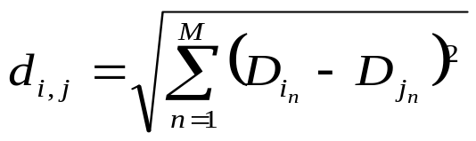
Distance
Many clustering algorithms, including k-means, require that a distance metric between points be defined.
A common distance metric is the Euclidean distance, which defines the distance, , between two points
and as
(4.5.2 )

Slide 94
Dimensions
The use of raw data to compute Euclidean distances may lead to distortions if the components of a point have very different relative values and ranges.
For instance, suppose that the workload of a Web server is described by points, each representing an HTTP request, of the type (f, c) where
  f is the size of the file retrieved by an HTTP request and
  c is the CPU time required to process the request.
Consider the point (25, 30) where f is measured in Kbytes and c in milliseconds.

Slide 95
Scaling
If f is now measured in Mbytes, the point (25, 30) becomes (0.025,30).
Such changes of units may result in the modification of the relative distances among groups of points [16].
Scaling techniques should be used to minimize problems that arise from the choice of units and from the different ranges of values of the parameters [16].
The k-means algorithm produces k clusters.
Each cluster is represented by its centroid, which is a point whose coordinates are obtained by computing the average of all the coordinates of the points in the cluster.

Slide 96

Algorithm
The algorithms starts by determining k points in the workload to act as initial estimates of the centroids of the k clusters.
The remaining points are then allocated to the cluster with the nearest centroid.
The allocation procedure iterates several times over the input points until no point switches cluster assignment or a maximum number of iterations is performed.
Having as input data the p points the steps required by the k-means algorithm are shown in Fig. 4.5.

Slide 97
Other Clustering Techniques
Another distance-based clustering algorithm is the minimum spanning tree algorithm described in [16].
Fractal-based clustering of E-commerce workloads is discussed in [15].

Slide 98
Figure 4.5. The k-means clustering algorithm.
1. Set the number of clusters to k.
Choose k starting points to be used as initial estimates of cluster centroids.
Examine each point of the workload and allocated it to the cluster whose centroid is nearest. The centroids position is recalculated each time a new point is added to the cluster.
Repeat step 3 until no point changes its cluster assignment during a complete pass or a maximum number of passes is performed.

Slide 99
Outline
4.1 Introduction
4.2 Performance Engineering
4.3 Motivating Example
4.4 A Model-based Methodology
4.5 Workload Model
    4.5.1 Types of Workload Models
    4.5.2 Clustering Analysis
4.6 Performance Models
4.7 Specifying Performance Objectives
    4.7.1 Specifying a Service Level Agreement
    4.7.2 Specifying Response Time
    4.7.3 Specifying Cost
4.8 Concluding Remarks
4.9 Exercises
Bibliography

Slide 100
Performance Models
Performance modelling is a key technique to understanding problems in IT systems.
Because it is difficult to estimate performance, IT systems must be designed with service levels in mind.
In other words, a designer of an IT service must know the limits of the system a priori.
For instance, a designer must know:
  the maximum number of transactions per second the system is capable of processing (i.e., an upper bound on throughput) or
  the minimum response time that can be achieved by a transaction processing system (i.e., a lower bound on response time).

Slide 101
Analytical Performance Models
Analytic performance models capture fundamental aspects of a computer system and relate them to each other by mathematical formulas and/or computational algorithms.
Several queuing network-based algorithms for solving open and closed models with multiple classes are provided in Part II of this book and are implemented in MS Excel workbooks.
The techniques include exact and approximate solutions.

Slide 102
Required Input
Basically, analytic performance models require input information such as
  workload intensity (e.g., arrival rate, number of clients, and think time) and the
  service demand placed by the basic component of the workload on each resource of the system.

Slide 103
Approximate Solutions
Many times, a relative or approximate performance estimate is all that is required.
Simply knowing that the throughput is
  approximately 120 tps for one system alternative and
  approximately 300 tps for another alternative is sufficient information to select one option over another.
These situations can be analyzed with simple performance bounding techniques presented in Chapter 3.

Slide 104
Detailed Models
Detailed performance models require parameters, which can be grouped into the following categories.
System parameters. Characteristics of a system that affect performance include,
  the number of processes in execution,
  the nature and intensity of inter-component communication,
  buffer sizes,
  maximum number of supported threads, and
  network protocols.

Slide 105
Resource Parameters
Intrinsic features of a resource that affect performance include
  disk seek times,
  latency,
  transfer rates,
  network bandwidth,
  router latency, and
  CPU speeds.

Slide 106
Workload parameters
Intensity
These parameters are derived from the workload characterization and are divided into two subcategories
1- Workload intensity parameters.
provide a measure of the load placed on a system, indicated by the number of units of work that contend for system resources.
  Examples include the
    number of sessions started per day,
    number of transactions/day to an application server,
    number of operations requiring secure connections/sec, and
    number of database transactions executed per unit time.

Slide 107
Workload parameters
Service Demand
2- Workload service demand parameters.
specify the total amount of service time required by each basic component at each resource.
    Examples include
    the CPU time of transactions at the application server,
    the total transmission time of replies from the Web server back to the customer, and
    the total I/O time at the database server for a query function.

Slide 108
Analyzing Goal
The critical goal of analyzing and designing IT systems is guaranteeing that performance objectives are satisfied.
  IT services are complex and can be very expensive.
  It is important to minimize the amount of guesswork when it comes to
    designing,
    implementing, and
    operating the systems that provide these services.

Slide 109
Outline
4.1 Introduction
4.2 Performance Engineering
4.3 Motivating Example
4.4 A Model-based Methodology
4.5 Workload Model
    4.5.1 Types of Workload Models
    4.5.2 Clustering Analysis
4.6 Performance Models
4.7 Specifying Performance Objectives
    4.7.1 Specifying a Service Level Agreement
    4.7.2 Specifying Response Time
    4.7.3 Specifying Cost
4.8 Concluding Remarks
4.9 Exercises
Bibliography

Slide 110
Specifying Performance Objectives
Users of IT services are generally not concerned with metrics such as
  CPU utilization,
  memory contention,
  network bandwidth,
  failure rates, router uptime, and
  other indicators of system performance.
On the contrary, users tend to be more interested in metrics related to quality of the services (QoS) provided by a system.

Slide 111
QoS Objective
QoS is indicated by specific objectives.
End-users want to know how well the system is performing and if they can get their work done on time.
Users perceive system services through performance metrics such as
  response time,
  availability,
  reliability,
  security, and
  cost.

Slide 112
Relation Between Users and System
Expected service levels govern the relationship between users and systems.
Performance objectives should be stated precisely.
In the process of analyzing system requirements, one should avoid vague statements such as the following:
  The system response time should be satisfactory to end users.
  The system availability should be adequate.
  The system should be as reliable as possible.

Slide 113
Simple and Precise Goals,
In contrast, performance goals should be stated in a simple and precise manner, such as:
  The system throughput should be greater than 1,000 query transactions per second, with at least 90% of the transactions responding in less than 2 sec.
  The application server should have an availability of 99.9% during the business hours of weekdays.

Slide 114
Simple and Precise Goals.
The response time of the patient information system should not exceed one second for local users.
  The mail server must be able to process at least 70,000 messages per day and 90% of the outgoing messages should not wait more than 2 minutes to be delivered.

Slide 115
Outline
4.1 Introduction
4.2 Performance Engineering
4.3 Motivating Example
4.4 A Model-based Methodology
4.5 Workload Model
    4.5.1 Types of Workload Models
    4.5.2 Clustering Analysis
4.6 Performance Models
4.7 Specifying Performance Objectives
    4.7.1 Specifying a Service Level Agreement
    4.7.2 Specifying Response Time
    4.7.3 Specifying Cost
4.8 Concluding Remarks
4.9 Exercises
Bibliography

Slide 116
Specifying a Service Level Agreement
Service Level Agreements (SLA) require IT to work with its end-users to define a list of services and their quality attributes, such as
  response time,
  availability,
  reliability,
  time-to-repair, and
  cost.
The values of SLAs are specific to each organization and are determined by both management and users.

Slide 117
SLA’s Usefulness
As shown in Fig. 4.6, an SLA is useful to manage IT services in various ways:
  1) planning, by determining what the service levels need to be, and
  2) assurance, by monitoring the service levels to ensure that they meet the specified requirements and by identifying problems when a service level is not met.
Performance engineering is a methodology to support and manage service level agreements.

Slide 118
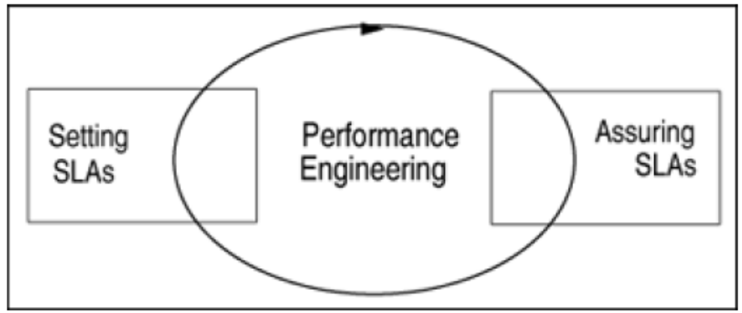
Figure 4.6. Performance Engineering process and SLAs.

Slide 119
SLA’s Forms
SLAs take different forms, depending on the nature of the IT service.
For instance, SLAs can be divided into different performance levels, such as
  basic,
  enhanced, and
  premium.
Each category typically incurs a different cost [10].

Slide 120
User Understanding of SLA
Users can then have a clear understanding of the resource and cost tradeoffs involved in
  designing,
  implementing, and
  operating an IT system [10].
Adequate capacity and infrastructure are provided so that acceptable or desirable values for performance metrics can be achieved.

Slide 121
Assess Current Levels
Before deciding on a particular service level for a system, one should assess the current level of service provided by the existing systems.
After assessing the current level of service, management faces the following question:
  Do the service levels need to be changed?
If they are unsatisfactory or expensive to the users or if they have to be changed as a function of business goals, new service levels should be established.

Slide 122
Service Level Establishment
The following are some helpful criteria to establish new service levels.
Cost x benefit. Service levels depend on
  the workload and
  the system configuration.
Improving service levels usually implies an expansion of system capacity.
This translates into cost.
A trade-off analysis between benefits and cost should be carried out.
For instance, response time is often reported to be inversely proportional to user productivity.

Slide 123
Cost x Benefit
The shorter the response time, the higher the productivity.
However, it is reasonable to ask whether productivity gains compensate for the additional cost incurred to reduce response time.
The better the service level, the higher the system cost.
Managers and users should discuss performance goals in light of the cost of providing IT services.

Slide 124
Nature of the application
To be acceptable to customers systems must provide fast response times.
An airline reservation system may guarantee that 90% of the transactions should respond in 3 sec or less, with an average of 1.5 sec.
An airline company may not afford to leave a reservation agent or an airport agent, who has to deal with passengers, waiting much longer than 3 sec [9].
Real-time applications that deal with customers, control manufacturing, and other critical systems must respond to requests within specified time limits.

Slide 125
Past Performance Goals
Performance levels attained in the past can help IT management and users reach an agreement for future service levels.
Users establish expectations based on their past experience about the time required to complete a given task.

Slide 126
Outline
4.1 Introduction
4.2 Performance Engineering
4.3 Motivating Example
4.4 A Model-based Methodology
4.5 Workload Model
    4.5.1 Types of Workload Models
    4.5.2 Clustering Analysis
4.6 Performance Models
4.7 Specifying Performance Objectives
    4.7.1 Specifying a Service Level Agreement
    4.7.2 Specifying Response Time
    4.7.3 Specifying Cost
4.8 Concluding Remarks
4.9 Exercises
Bibliography

Slide 127
Specifying Response Time
Response time is a critical factor to users of interactive systems.
People interact so often with computer-based systems, everyone agrees that response time is an important determinant of
  personal productivity,
  error rates, and
  satisfaction [21].
It is evident that user satisfaction increases as response time shortens.

Slide 128
Response Time Variation
Modest variations around the average response time are acceptable, but large variations may affect user behaviour.
A frequently asked question is:
  How should one set appropriate response time limits for a given system?
  The answer depends on how system response time affects user's performance.
Adequate response time limits for a specific system and a user community can be determined by measuring the impact on user's productivity and by estimating the cost of providing improved response times.

Slide 129
User Behavior
Guideline about computer response time and user behaviour exist and the behaviour of human-computer interactions have been studied extensively [17, 18].
Regarding the response time of a system:
  0.1 second is about the limit when a user perceives that the system is reacting instantaneously.
  1.0 second is about the limit when the flow of thought of a user is not interrupted, although the user may notice the delay.
  10 seconds is about the limit when a user loses attention and the interaction with the system is disrupted.

Slide 130
Outline
4.1 Introduction
4.2 Performance Engineering
4.3 Motivating Example
4.4 A Model-based Methodology
4.5 Workload Model
    4.5.1 Types of Workload Models
    4.5.2 Clustering Analysis
4.6 Performance Models
4.7 Specifying Performance Objectives
    4.7.1 Specifying a Service Level Agreement
    4.7.2 Specifying Response Time
    4.7.3 Specifying Cost
4.8 Concluding Remarks
4.9 Exercises
Bibliography

Slide 131
Specifying Cost
The estimation of the cost of developing and delivering IT systems is an essential component of a performance engineering methodology.
The system life cycle involves a number of design trade-offs with significant cost and performance implications.
For example,
  the choice of thin clients versus fat clients to execute networked applications,
  the choice of the number of architectural layers of a system, and
  the choice of the number and capacity of servers of a data center affect both the performance and the cost of a system [3].

Slide 132
Cost Estimation
Without cost estimates, it is meaningless to discuss service level and performance objectives for a specific business.
Managers need to calculate cost and estimate benefits to make good IT decisions.
For example, to specify the availability goals for a credit card authorization system or a catalogue sales center, one has to know the cost of a minute of downtime.
Depending on the nature of the application, the average cost of one minute of downtime can be as high as $100,000 in the case of systems that support brokerage operations [19].

Slide 133
Ownership Cost
The Total Cost of Ownership (TCO) [20] model has been applied to evaluate the cost of a system.
It means the total cost of owing a given system over some time horizon (e.g., five-year period).
TCO intends to identify and measure elements of IT expenses beyond the initial cost of implementing a system.

Slide 134
TCO Items,
The most significant contributing items to TCO are:
Hardware costs, including acquisition expenses or leasing expenses of equipment, such as servers, storage boxes, and connectivity components.
Software costs, including personal productivity software, applications, database management, transaction monitors, intrusion detection, performance monitoring, and operating system software.
Communication costs, including leased lines and communication services access.
Management costs, including network management, systems storage, maintenance, and outsourced services.

Slide 135
TCO Items.
Support costs, including support services, support personnel training, end-user training, and help desk services.
Facilities costs, including leasing of physical space, air conditioning, power, and physical security.
Downtime costs, including both the cost of lost productivity of employees and the cost of lost income from missed business [19].

Slide 136
Return on Investment,
Measuring the Return on Investment (ROI) is also critical to evaluate the cost and benefits of a system.
To measure the success of the investment of information technology two factors are considered:
  the improvement in the quality of service (e.g., user satisfaction and system use) and
  the return on investment (e.g., increased productivity and organizational impact).

Slide 137
Return on Investment.
Thus, ROI methodologies are useful for analyzing the cost/benefits of IT projects.
Based on the requirement analysis of a system, one should develop a cost model to understand the cost/benefits of the system.
When different system choices are evaluated, one needs to predict how much additional computing and communication resources will be needed for each choice and how much these elements cost now and in the future.

Slide 138
Example 4.6
Consider the call center system described in the motivating example.
Management is planning to replace the database server with a powerful cluster of servers.
Two brands of clusters are being compared, system Y and system Z.
What factors should be considered in the process of choosing between the two systems?

Slide 139
Factors be considered in choosing between two systems: TCO
IT management is considering the TCO model, instead of the pure purchase cost of the system.
Thus, the basic cost of both systems includes
  hardware and software costs,
  hardware and software maintenance,
  operational personnel, and
  facilities costs for a three-year period.
System Y costs $300,000 and
system Z costs $350,000.

Slide 140
Factors be considered in choosing between two systems: Performance
IT management is looking at the performance attributes of both systems.
Standard benchmarks indicate that the
  throughput of systems Y and Z are 220 tps and 230 tps with 90% of the transactions responding in less than 0.5 sec, respectively.

Slide 141
Factors be considered in choosing between two systems: Dependability
IT management is evaluating other aspects of computing in their analysis.
In addition to performance, management also consider the dependability of the systems [19].
Information obtained on the dependability of the two systems suggests an expected
  38 hours of unavailability for system Y and
  21 hours of downtime for system Z, over a period of three years

Slide 142
Factors be considered in choosing between two systems: Costs
The call center charges $5 per call from customers.
The company estimates that in the next three years, the average rate of telephone calls into the call center will be 1,000/hour.
Therefore, the estimated average cost per hour of downtime due to revenue loss is $5,000.
The total cost of a system is calculated as:

Slide 143
System Selection
Using the above expression, the total cost for a three-year period for the two systems is:
  Cost of system Y = 300,000 + 38 x 1000 x 5 = $490,000
  Cost of system Z = 350,000 + 21 x 1000 x 5 = $455,000
The above methodology helps management justify selecting system Z.
Although Z is more expensive initially, it is more dependable, which makes its total cost more attractive.

Slide 144
Outline
4.1 Introduction
4.2 Performance Engineering
4.3 Motivating Example
4.4 A Model-based Methodology
4.5 Workload Model
    4.5.1 Types of Workload Models
    4.5.2 Clustering Analysis
4.6 Performance Models
4.7 Specifying Performance Objectives
    4.7.1 Specifying a Service Level Agreement
    4.7.2 Specifying Response Time
    4.7.3 Specifying Cost
4.8 Concluding Remarks
4.9 Exercises
Bibliography

Slide 145
Concluding Remarks
The principle concepts of performance engineering are presented in this chapter.
A motivating example is described involving
  the planning,
  development, and
  implementation of a call center application.
Five examples of how performance considerations should be included in the
  analysis,
  design,
  operation, and
  evolution of a system are presented.

Slide 146
Concluding Remarks-1
The main issue in performance engineering is how to guarantee that a system will meet its performance goals.
The steps required to carry out a performance engineering effort are described.
A central issue in the methodology are the models needed to represent workload and the performance of a system.
The basic steps of a practical performance engineering methodology include the following.
  Specify the system performance goals.
  Understand the current environment.

Slide 147
Concluding Remarks-2
Perform a workload characterization and generate a workload model.
Develop a performance model.
Verify and validate the system model, which is composed of the workload and performance models.
Forecast workload growth.
Use the system model to analyze the performance of different system architectures and various workload scenarios.
Select the best alternative (based on the performance model predictions) that presents the best cost-performance relation while satisfying the service levels specified.

Slide 148
Outline
4.1 Introduction
4.2 Performance Engineering
4.3 Motivating Example
4.4 A Model-based Methodology
4.5 Workload Model
    4.5.1 Types of Workload Models
    4.5.2 Clustering Analysis
4.6 Performance Models
4.7 Specifying Performance Objectives
    4.7.1 Specifying a Service Level Agreement
    4.7.2 Specifying Response Time
    4.7.3 Specifying Cost
4.8 Concluding Remarks
4.9 Exercises
Bibliography

Slide 149
Exercises
Consider the motivating example of Section 4.3. Describe the performance requirements of the system. Be as precise as possible.
Assume that the design phase of the call center application has been completed. Analysts are now working on the development phase. Describe the workload model for the two stages and comment on the additional information that could be added to the model during the development phase.
Consider the call center motivating example and the data provided in Example 4.4. What is the maximum throughput that can be achieved by the database server?

Slide 150
Exercises
In the architecture of the motivating example, the application server receives and executes the functions submitted by the representatives. Suppose that the application server has 150 active processes that service the received functions. The analyst monitors the system and verifies that an application process executes for an average of 550 msec between database server requests. The database server handles 120 requests/sec. What is the average database response time?

Slide 151
Exercises
In Example 4.4, the workload model consists of two classes of transactions. Aggregate these two classes into a single class. What is the bottleneck of the server? What is the maximum throughput achieved by the server, in terms of the aggregated transaction?

Slide 152
Outline
4.1 Introduction
4.2 Performance Engineering
4.3 Motivating Example
4.4 A Model-based Methodology
4.5 Workload Model
    4.5.1 Types of Workload Models
    4.5.2 Clustering Analysis
4.6 Performance Models
4.7 Specifying Performance Objectives
    4.7.1 Specifying a Service Level Agreement
    4.7.2 Specifying Response Time
    4.7.3 Specifying Cost
4.8 Concluding Remarks
4.9 Exercises
Bibliography

Slide 153
Bibliography-1
V. A. F. Almeida, M. Crovella, A. Bestravos, and A. Oliveira "Characterizing reference locality in the WWW," Proc. IEEE/ACM International Conference on Parallel and Distributed System (PDIS), December 1996, pp. 92–107.
V. A. F. Almeida and D. A. Menascé, "Capacity planning: An essential tool for managing Web services," IEEE IT Professional, vol. 4, no. 4, July / August 2002.
D. Ardagna and C. Francalanci, "A cost-oriented methodology for the design of Web-based IT architectures," Proc. 17th ACM Symposium on Applied Computing, Madrid, March 2002.

Slide 154
Bibliography-2
M. Barbacci, T. Longstaff, M. Klein, and C. Weinstock, "Quality Attributes," Technical Report CMU/SEI-95-TR-021, Software Engineering Institute, December 1995.
R. Bodnarchuk and R. Bunt, "A synthetic workload model for a distributed file system," Proc. 1991 SIGMETRICS Conf. Measurement Comput. Syst., ACM, May 1991.
M. Calzarossa and G. Serazzi, "Workload characterization," Proc. IEEE, vol. 81, no. 8, August 1993.

Slide 155
Bibliography-3
R. Dumke, C. Rautenstrauch, A. Schmietendorf, and A. Scholz (eds.), Performance Engineering: State of the Art and Current Trends, LNCS, vol. 2047, Springer, 2001.
D. Ferrari, G. Serazzi, and A. Zeigner, Measurement and Tuning of Computer Systems, Prentice Hall, Upper Saddle River, New Jersey, 1983.
D. Gifford and A. Spector, "The TWA reservation system," Comm. ACM, vol. 27, no. 7, July 1984.
C. Koch, "Put IT in Writing," CIO Magazine, November 15, 1998.

Slide 156
Bibliography-4
M. Klein, "State of the Practice Report: Problems in the Practice of Performance Engineering," Technical Report CMU/SEI-95-TR-020, Software Engineering Institute, February 1996.
D. Levine, P. Ramsey, and R. Smidt, Applied Statistics for Engineers and Scientists: Using Microsoft Excel & MINITAB, Prentice Hall, Upper Saddle River, New Jersey, 2001.
D. A. Menascé, V. A. F. Almeida, R. Riedi, F. Pelegrinelli, R. Fonseca, and W. Meira Jr., "In search of invariants for E-business workloads," Proc. 2000 ACM Conf. in E-commerce, Minneapolis, Minnesota, October 17-20, 2000.

Slide 157
Bibliography-5
D. A. Menascé and V. A. F. Almeida, Capacity Planning for Web Services: Metrics, Models, and Methods, Prentice Hall, Upper Saddle River, New Jersey, 2002.
D. A. Menascé, B. Abrahão, D. Barbará, V. A. F. Almeida, and F. Ribeiro, "Characterizing E-Business Workloads Using Fractal Methods," J. Web Engineering, Rinton Press, vol. 1, no. 1, 2002, pp. 74–90.
D. A. Menascé, V. A. F. Almeida, and L. W. Dowdy, Capacity Planning and Performance Modeling: From Mainframes to Client-Server Systems, Prentice Hall, Upper Saddle River, New Jersey, 1994.

Slide 158
Bibliography-6
R. B. Miller, "Response time in man-computer conversational transactions," Proc. AFIPS Fall Joint Comp. Conf., 33:267–277, December 1968.
J. Nielsen, Usability Engineering, Morgan Kaufmann, San Francisco, California, 1994.
D. Patterson, "A simple way to estimate the cost of downtime," Proc. 16th Systems Administration Conference (LISA '02), USENIX, 2002.
E. Schaider. "TCO in the Trenches," Software Magazine, December 1999.
B. Schneiderman, "Response time and display rate in human performance with computers," Computing Surveys, ACM, vol. 16, no. 3, September 1984.

Slide 159
Bibliography-7
E. Shriver, Performance Modeling for Realistic Storage Devices, Ph.D. dissertation, Computer Science Dept., New York Univ., May 1997.
P. Singleton, "Performance modeling - what, why, when and how," BT Technology Journal, vol. 20, no. 3, July 2002.
C. U. Smith, Performance Engineering of Software Systems, Addison-Wesley Publishing Company, Inc., 1990.
C. U. Smith and L. G. Williams, Performance Solutions: a Practical Guide to Creating Responsive, Scalable Software, Addison-Wesley Publishing Company, Inc., 2002.

